Slide 1

Lifespan Development
Chapter 9

Slide 2
Agenda
What is Lifespan Development?
Lifespan Theories
Stages of Development
Death and Dying

Slide 3
Developmental Domains
Physical
Cognitive
Psychosocial

Slide 4
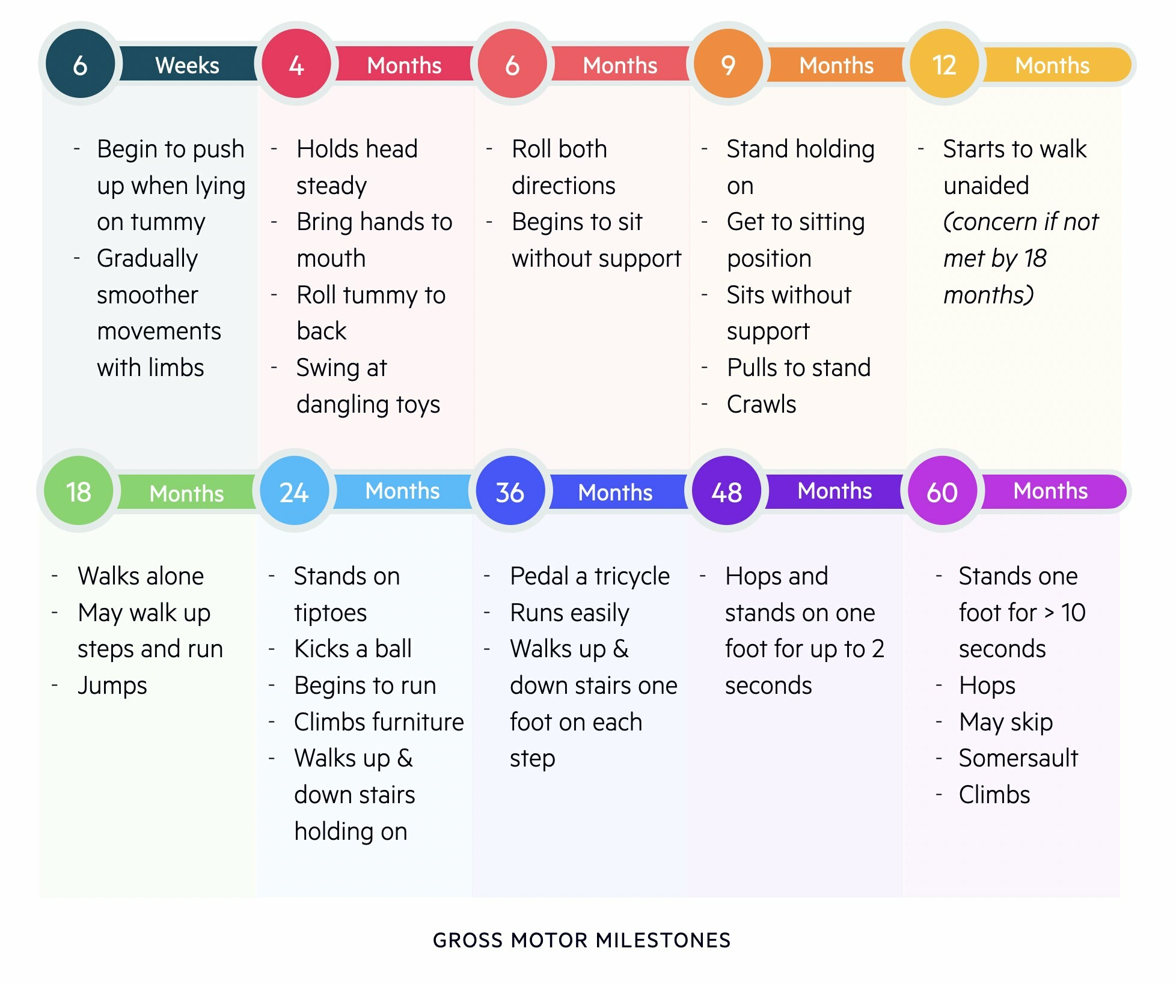
Developmental Milestones
The normative approach- “What is normal development?”

Slide 5
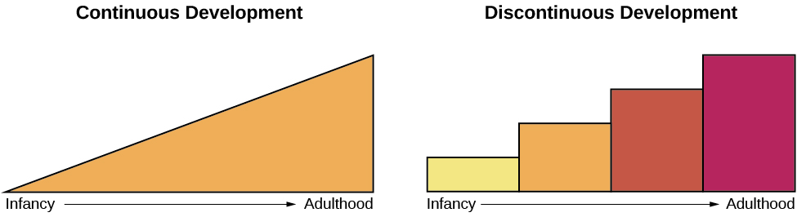
How do we develop?

Slide 6
Questions, Questions, Questions
Does everyone develop at the same rate?
How does culture impact development?
How do nature and nurture influence development?

Slide 7

Theory Time!

Slide 8
Psychosexual Theory of Development
Age (years) | Stage | Development Activities
0–1 | Oral stage | Children derive pleasure from oral activities, such as sucking and tasting
2–3 | Anal stage | Children begin potty training
3-6 | Phallic stage | Boys are more attracted to their mother, girls are more attracted to their father
6-puberty | Latency stage | Children spend most of their time with same sex peers (minimal sexual development)
Beyond puberty | Genital stage | Individuals are attracted to opposite sex partners
Sigmund Freud

Slide 9
Psychosocial Theory of Development
Stage | Age (years) | Developmental Task | Description
1 | 0–1 | Trust vs. mistrust | Trust (or mistrust) that basic needs, such as nourishment and affection, will be met
2 | 1–3 | Autonomy vs. shame/doubt | Develop a sense of independence in many tasks
3 | 3–6 | Initiative vs. guilt | Take initiative on some activities—may develop guilt when unsuccessful or boundaries overstepped
4 | 7–11 | Industry vs. inferiority | Develop self-confidence in abilities when competent or sense of inferiority when not
5 | 12–18 | Identity vs. confusion | Experiment with and develop identity and roles
6 | 19–29 | Intimacy vs. isolation | Establish intimacy and relationships with others
7 | 30–64 | Generativity vs. stagnation | Contribute to society and be part of a family
8 | 65– | Integrity vs. despair | Assess and make sense of life and meaning of contributions
Erik Erikson

Slide 10
Cognitive Theory of Development
Age (years) | Stage | Description | Developmental issues
0–2 | Sensorimotor | World experienced through senses and actions | Object permanence Stranger anxiety
2–6 | Preoperational | Use words and images to represent things, but lack logical reasoning | Pretend play Egocentrism Language development
7–11 | Concrete operational | Understand concrete events and analogies logically; perform arithmetical operations | Conservation Reversibility Mathematical transformations
12– | Formal operational | Formal operations Utilize abstract reasoning | Abstract logic Moral reasoning
Jean Piaget

Slide 11
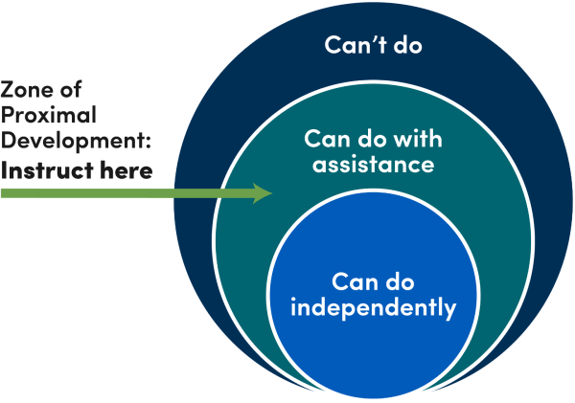
Sociocultural Theory of Development
Lev Vygotsky

Slide 12
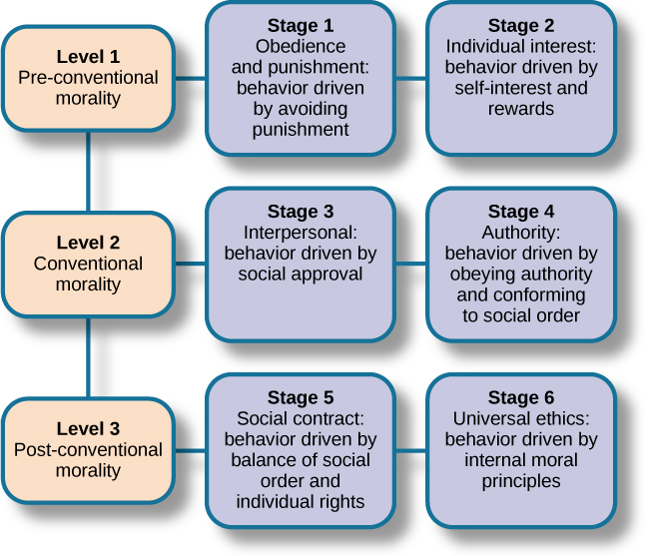
Moral Theory of Development
Kohlberg’s Stages of Moral Reasoning
Lawrence Kohlberg

Slide 13

Stages of Development

Slide 14

https://www.youtube.com/watch?v=GE_lI86boUU&t=4s

Slide 15
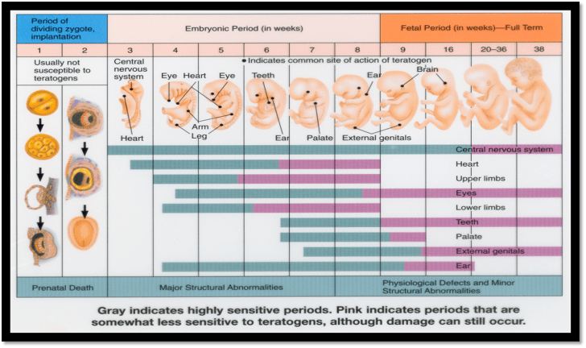
Prenatal Development Stages

Slide 16
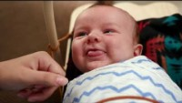
Newborn Reflexes
Root
Suck
Tonic Neck
Grasp
Step
Moro
https://www.youtube.com/watch?v=0vrdkzOnGgo

Slide 17
Developmental Milestones, Ages 2-5 Years
Age (years) | Physical | Personal/Social | Language | Cognitive
2 | Kicks a ball; walks up and down stairs | Plays alongside other children; copies adults | Points to objects when named; puts 2–4 words together in a sentence | Sorts shapes and colors; follows 2-step instructions
3 | Climbs and runs; pedals tricycle | Takes turns; expresses many emotions; dresses self | Names familiar things; uses pronouns | Plays make believe; works toys with parts (levers, handles)
4 | Catches balls; uses scissors | Prefers social play to solo play; knows likes and interests | Knows songs and rhymes by memory | Names colors and numbers; begins writing letters
5 | Hops and swings; uses fork and spoon | Distinguishes real from pretend; likes to please friends | Speaks clearly; uses full sentences | Counts to 10 or higher; prints some letters and copies basic shapes

Slide 18
Attachments Mary Ainsworth and the Strange Situation
Secure attachment
Avoidant attachment
Resistant attachment
Disorganized attachment

Slide 19
Parenting Styles
Authoritative style
Authoritarian style
Permissive style
Uninvolved style
Something to consider: How do each of these impact a child’s developing sense of self?

Slide 20
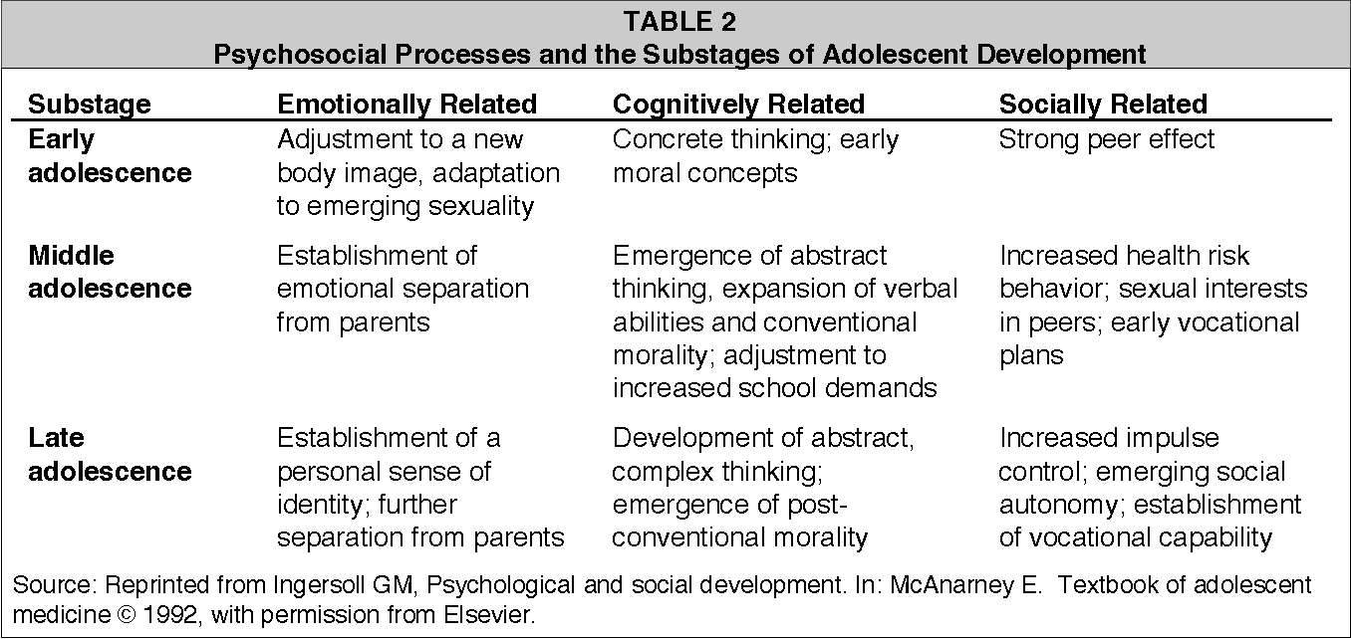
Adolescence

Slide 21
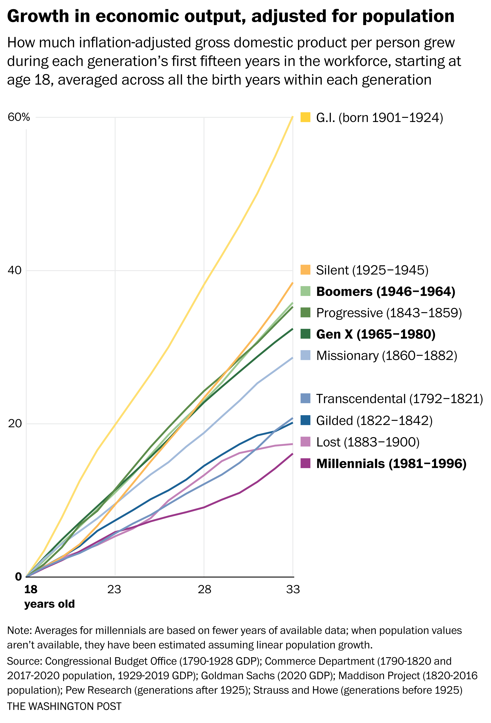
Emerging Adulthood

Slide 22

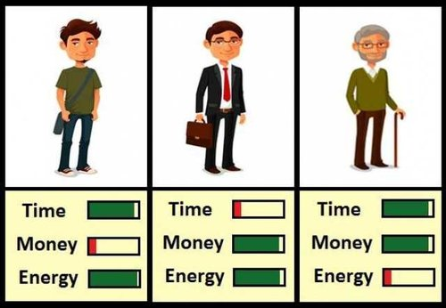
Adulthood
Socioemotional Selectivity Theory

Slide 23
The Legalities of Aging
Hospice
Living will/ advanced directive
Do Not Resuscitate Order
Health care proxy
Power of attorney

Slide 24
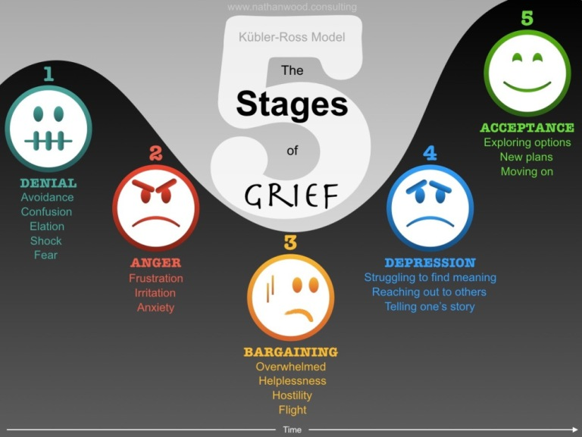
Grief and Processing
The Kubler-Ross Five-Stage Theory
The Ball-in-the-Box Analogy

Slide 25
Next time on PSY 203…
BEFORE NEXT CLASS:
Read Chapter 11 & take the quiz
NOTE: We are skipping Chapter 10 for now
Complete Exam 2 Reflection
Due tonight at 11:59 pm
NEXT CLASS:
Chapter 11- Personality
NOTE: We are skipping Chapter 10 for now

